Slide 1

Predict Political Advertisements from Facebook by Learning from the Dataset Collected from the Facebook Users
Team No.4
Yi Ren 001050300 Yuchen Zhao 001089667
Instructor: Dr. Liu Handan

Slide 2

01 / Introduction
02 / Methodology
03 / Data Sources
CONTENTS
04 / Results and Analysis
05 / Conclusion
06 / References

Slide 3
1
PART ONE
Introduction

Slide 4

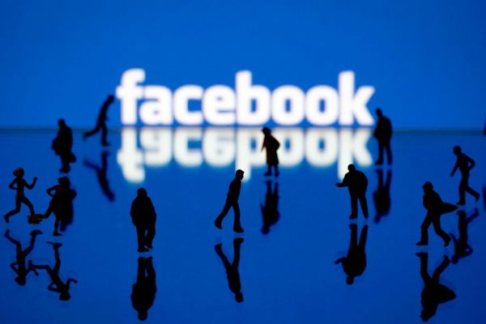

Instruction
In November this year, the United States will have a new presidential election. Therefore, our group chose to study and predict whether the ads on Facebook are political. The data set selected is Kaggle’s research on related issues. The data level is 3 GB. The data format is CSV, which contains 24 feature values.
i. Background
The reason why our team conducts research on the prediction of political advertisements on Facebook is that on the one hand, it mainly combines current political factors. On the other hand, there are relatively few cases of this type of data analysis before, so we can gain new knowledge through learning and innovation.

Slide 5
Instruction
Content:
This database is created by Andriy Samoshin, he collected the database using the browser extensions. The newest date is on 03-27-2019. This database is very authoritative and reliable.
The data is explained by the following factors:
ID | HTML | Political | Not_political | Title | Message
Thumbnail | Created_at | Updated_at | Lang | Images | Impressions
Political_ probalitity | Targeting | Suppressed | Targets | Advertiser | Entities
Page | Lower_page | Targetings | Paid_for_by | Targetedness | Listbuilding_fundrasing_proba

Slide 6
Instruction
Motivations:
Our team wants to predict Political Advertisements from Facebook by Learning from the Dataset Collected from the Facebook Users. The 2020 US election is about to take place, so this forecast also has certain political timeliness. We want to use many different methodologies to finish this research.
ⅲ. Goal:
We hope to use machine learning data with parallel computing to successfully predict whether Facebook ads are political.

Slide 7
2
PART TWO
Methodology

Slide 8
Methodology
ii. Specific
Implementation
i. Method Introduction

Slide 9
i . Method Introduction
At first, we use some ways to make the data visible in order to distinguish the features which can be used in our research.
After seeing the 24 features ​​of this data set, we discussed whether to use classifier or regression analysis to learn and predict the problem. After repeated practice and repeated determination, we decided to use both regression, which the label remains a value of probability, and classifier, which the label of probability is set to 0 which refers to not political and 1 which refers to political.
Our team use about 14 kind of methods
Methods Name
TensorFlow | Snowball Stemmer
Word Cloud | k Nearest Neighbors
Decision Tree | Random Forest
Logistic Regression | Naive Bayes
SGD Classifier | Linear Regression
K-fold Cross-Validation | Multi-process parallel computing
Pytorch uses GPU efficiently | Neural Network

Slide 10
ⅱ. Specific Implementation
i) Naive Bayes Algorithm
ii) TensorFlow
iii) K-fold Cross Validation & Data Parallelism
iv) Neural network & GPU data parallelism

Slide 11
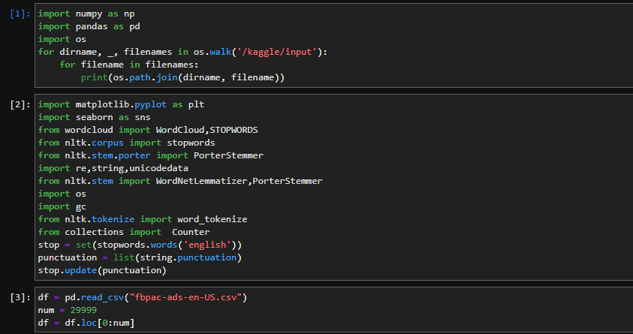
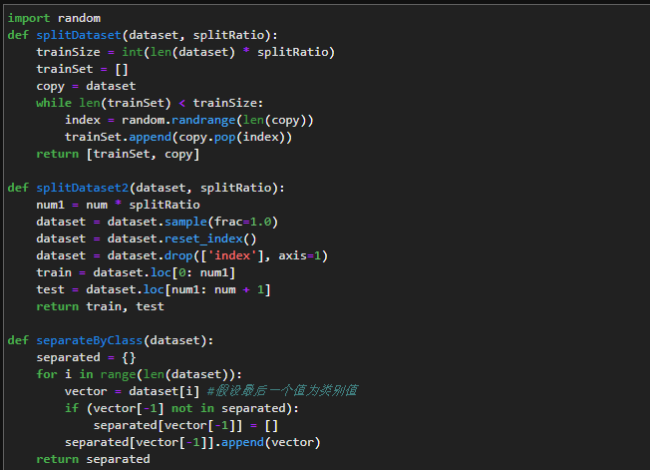
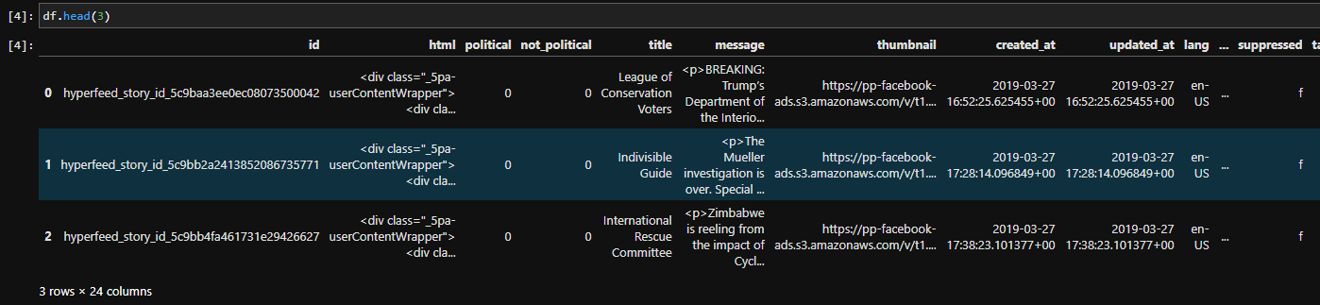
ⅱ. Specific Implementation
i) Naive Bayes Algorithm:
Step2: Extract data features:
Step1: Processing data:
(1) Divide data by category

Slide 12
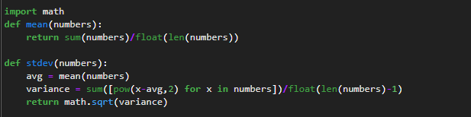
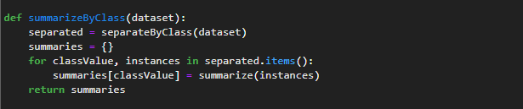

ⅱ. Specific Implementation
i) Naive Bayes Algorithm:
(2) Calculate the mean and standard deviation
(4) Extract attribute features by category
(3) Extract the features of the data set

Slide 13
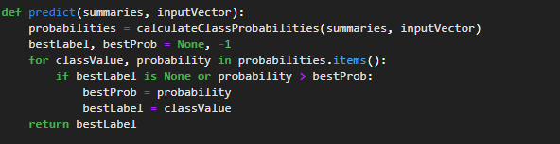

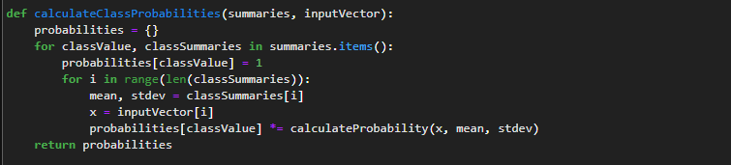
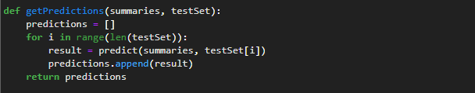
ⅱ. Specific Implementation
i) Naive Bayes Algorithm:
Step3: Forecast:
(3) Single prediction
Calculate the probability density function of Gaussian distribution (normal distribution)
(2) Calculate the probability of the class
(4) Multiple predictions

Slide 14
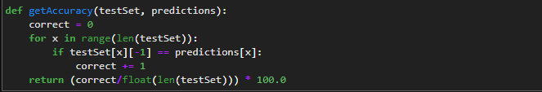
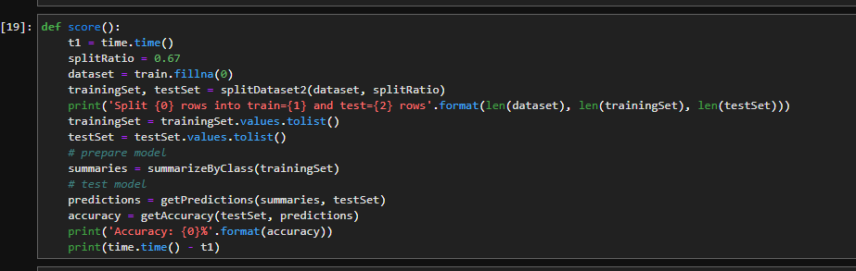
ⅱ. Specific Implementation
i) Naive Bayes Algorithm:
Step4: Evaluation accuracy:
Step5: Conclusion:
In our practice of naive Bayes algorithm, our results are not very ideal, but our learning, trying and summarizing process has benefited us a lot, and we will also cross Naive Bayes and K-fold in the follow-up The verification method has been combined with experiments, and some results have been obtained.

Slide 15
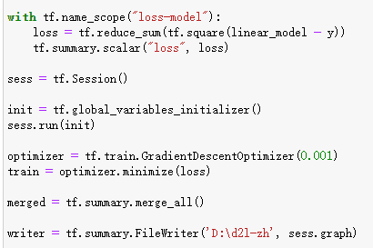
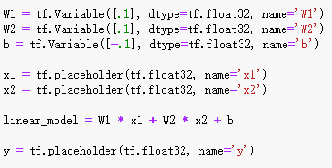
ⅱ. Specific Implementation
ii) TensorFlow:
Step1: Initialize parameters:
Step2: Define the model:

Slide 16
ⅱ. Specific Implementation
ii) TensorFlow:
Step1: Initialize parameters:
Step2: Define the model:

Slide 17
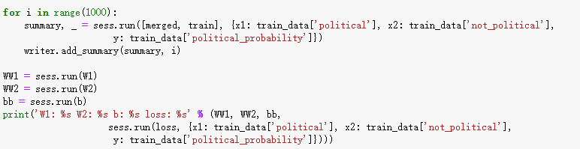
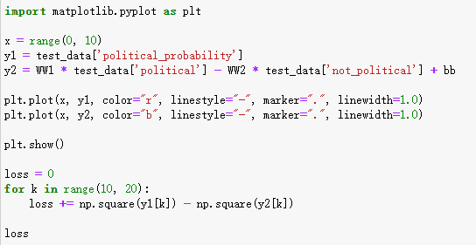
ⅱ. Specific Implementation
ii) TensorFlow:
Step3: Training model and printing the results:

Slide 18
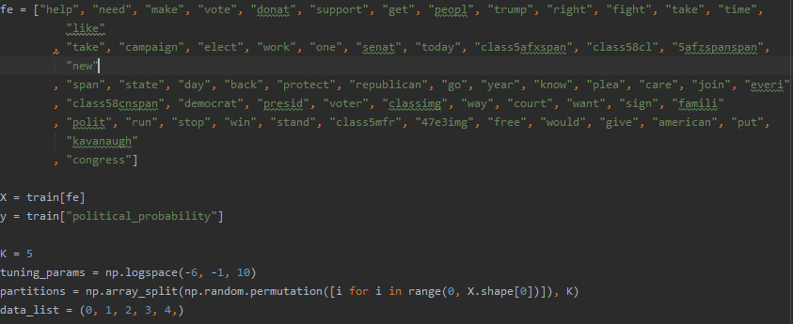
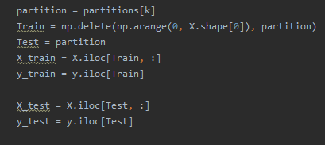

ⅱ. Specific Implementation
iii) K-fold Cross Validation & Data Parallelism:
Step1: Initializing parameters:
Defining testing set and training set:
Defining tuning parameter:

Slide 19
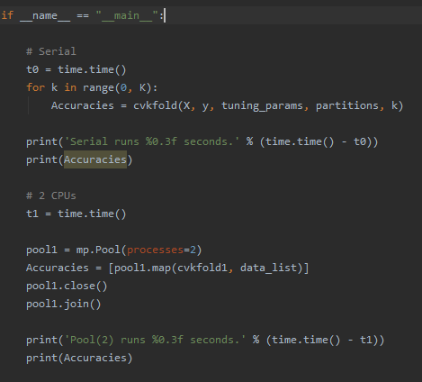
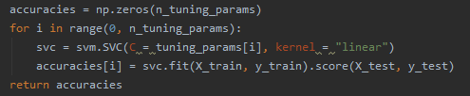
ⅱ. Specific Implementation
iii) K-fold Cross Validation & Data Parallelism:
Step 2: Training model:
Step3: Data Parallelism:

Slide 20
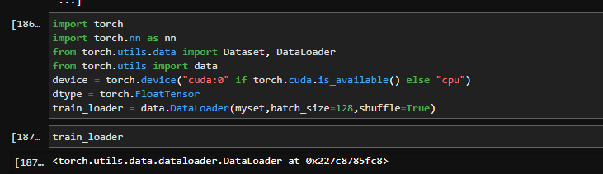
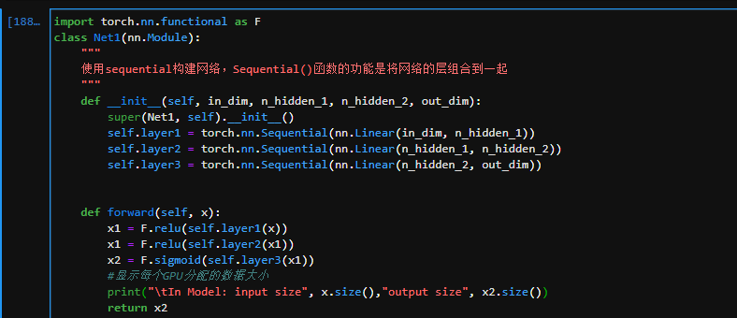
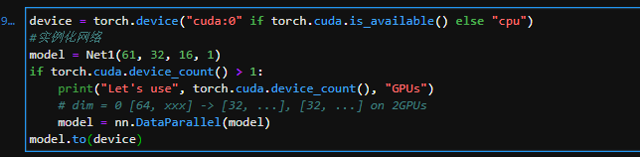
ⅱ. Specific Implementation
iv) Neural network & GPU data parallelism:
Import the package corresponding to torch, some related tools, and data loading:
Convert the model to a multi-GPU concurrent processing format, the number of the neurons of each layers are set to 61, 32, 16, 1:
Define the neural network which contains one input layer, one output layer and two hidden layers:

Slide 21
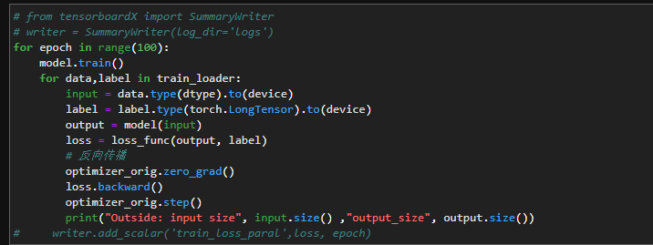

ⅱ. Specific Implementation
iv) Neural network & GPU data parallelism:
Choose optimizer and loss function, the learning rate is set to 0.01 and the loss is set as the Binary Cross-Entropy Loss:
Model training and visualize the loss value.

Slide 22
3
PART THTEE
Data Sources (download link)

Slide 23
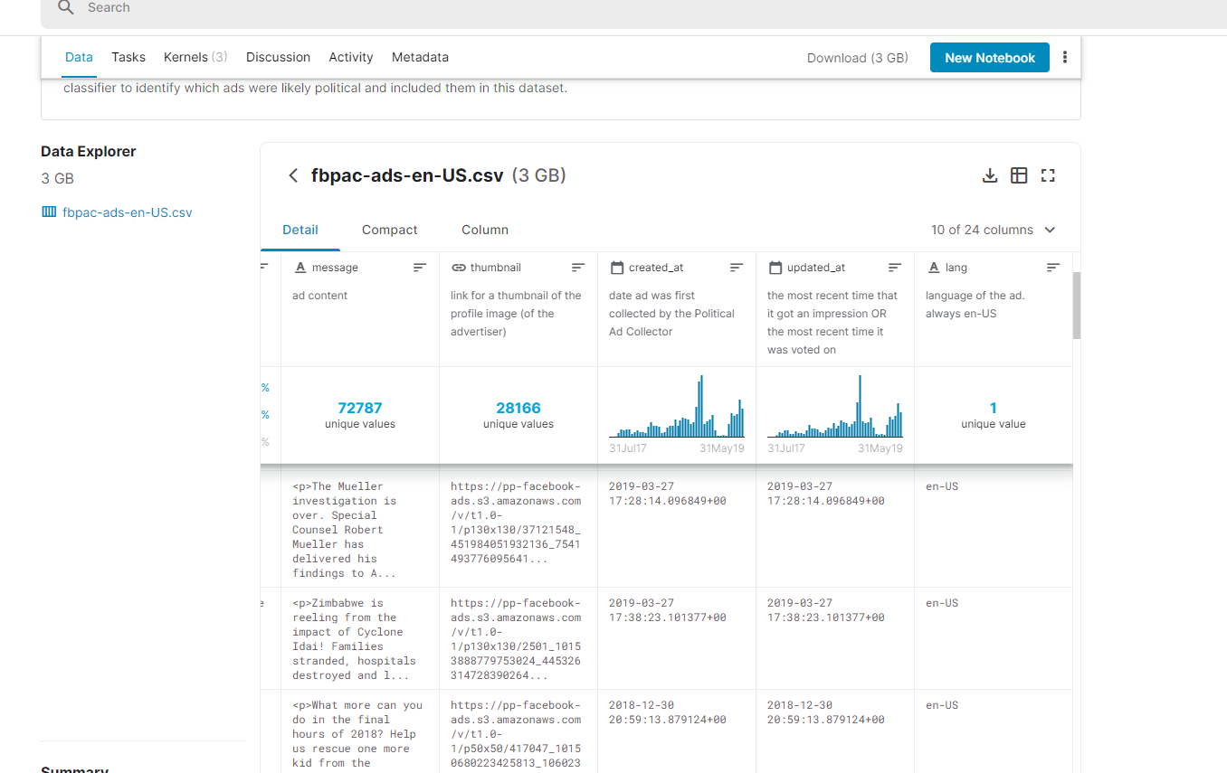
Data Sources (download link):
Data Sources (download link):
https://www.kaggle.com/mrmorj/political-advertisements-from-facebook

Slide 24
4
PART FOUR
Results and Analysis

Slide 25
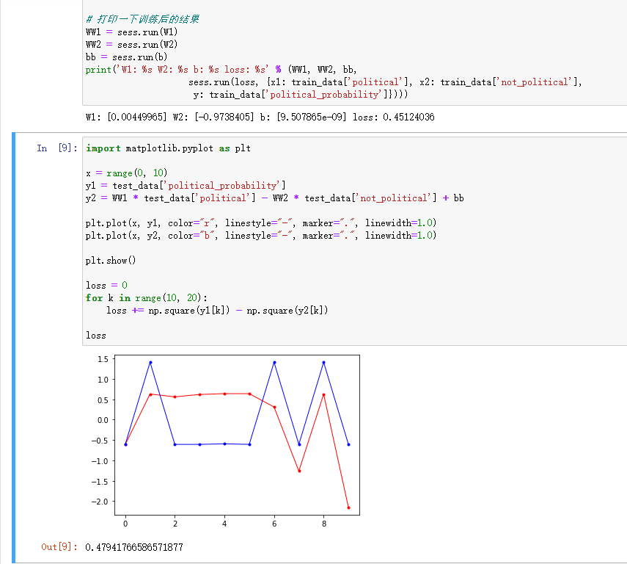
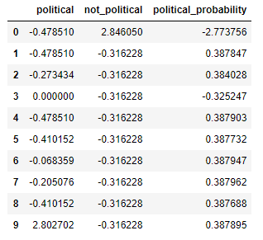
Results and Analysis
Plan I: Linear regression under the Tensorflow framework
ⅰ. Data Processing:
ⅱ. Linear Regression:

Slide 26
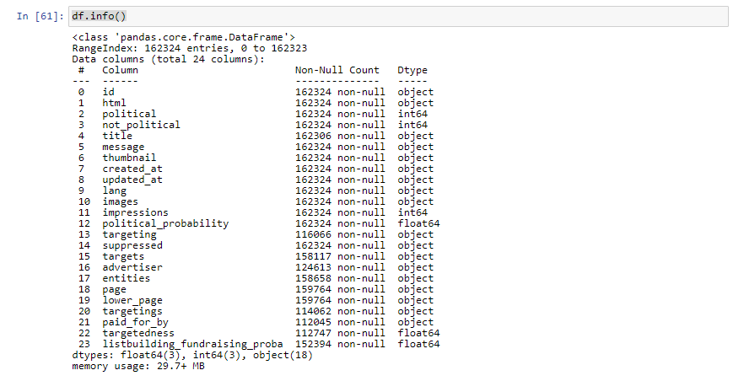
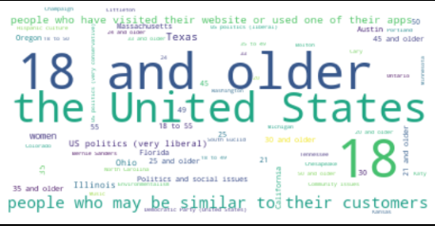
Results and Analysis
Plan II: Visualization & Comprehensive Methods
ⅰ. Visualization:
Data information:
Word Cloud:

Slide 27
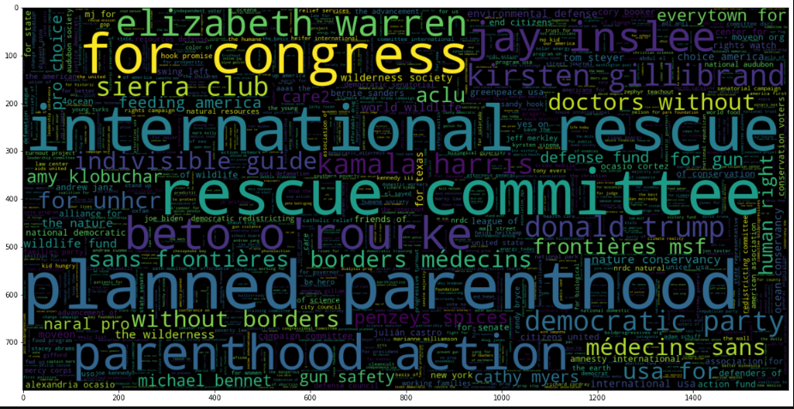
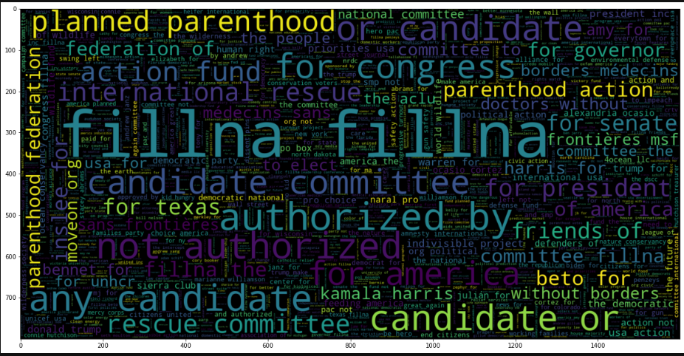
Results and Analysis
Title political word:
Paid for by:

Slide 28
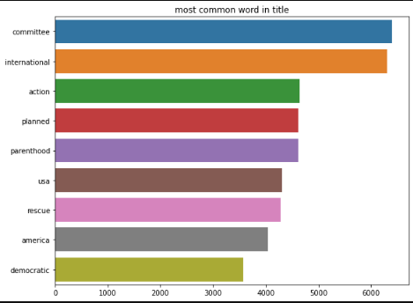
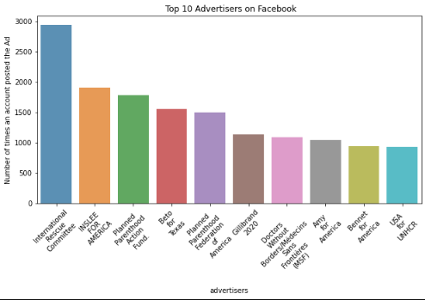
Results and Analysis
Bar Graph:
Top 10 advertisers on Facebook:

Slide 29
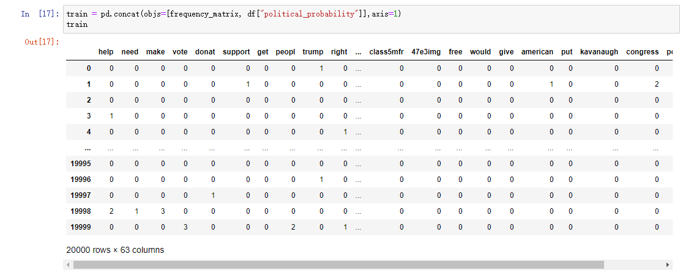
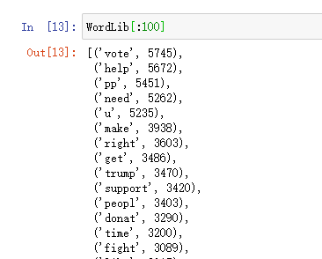
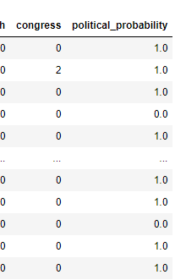
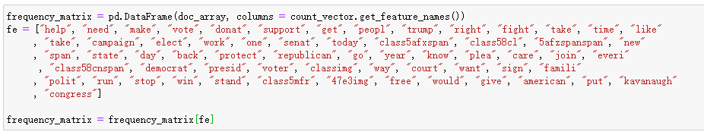
Results and Analysis
ⅱ. Data Processing:

Slide 30
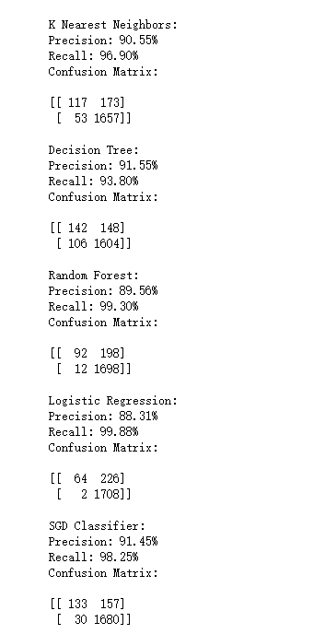
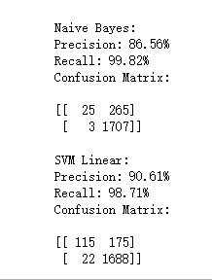
Results and Analysis
ⅲ. Modules:

Slide 31
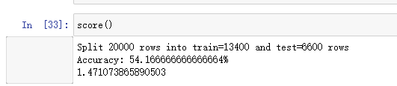
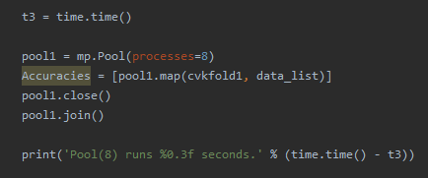

Results and Analysis
Plan III: Naive Bayes and K-fold (Cross-validation) [CPU]
i. Naïve Bayes:
Multiprocessing is also implemented in this part:
ii. K-fold (Cross-validation) & data parallelism:

Slide 32
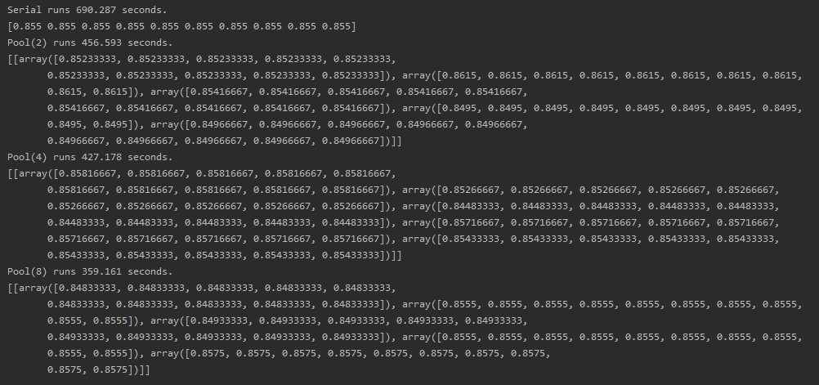
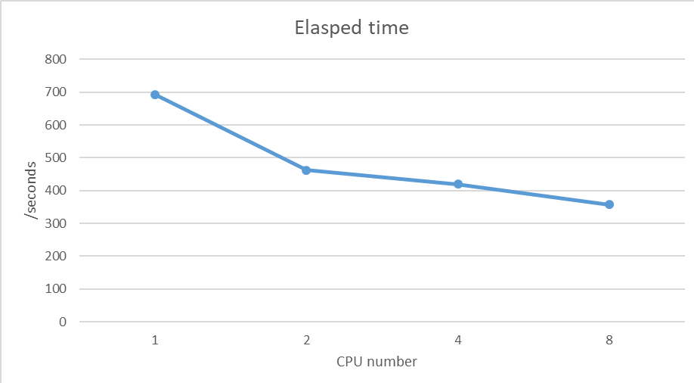
Results and Analysis
The result turns out to be:
As can be seen in the plot, the more CPUs are used, the faster the operation is, and there is no remarkable difference between the accuracies when using different quantities of CPUs.

Slide 33
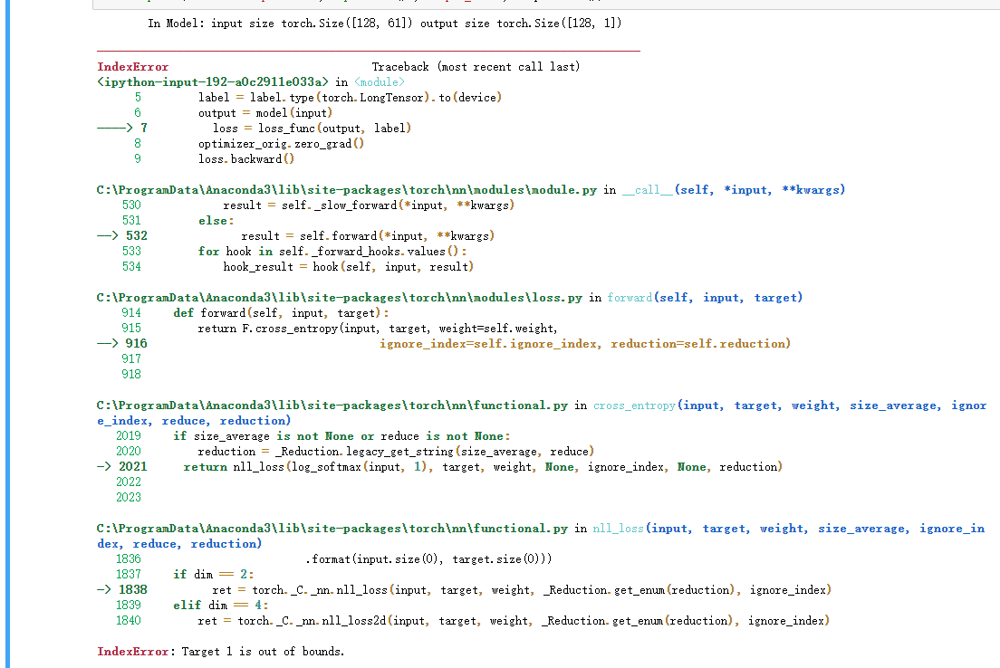
Results and Analysis
Plan Ⅳ: Neural Network [GPU]

Slide 34
5
PART FIVE
Conclusion

Slide 35
ⅰ. Linear regression under the Tensorflow framework:
The loss of the training set is 0.45124036 and that in testing set is 0.47941766586571877. They are close to each other which means the training is effective. However, the plot shows that although the prediction and the labels are similar to each other, they still have some obvious difference. However, when the quantity of sample is set to a bigger one such as 10000, the gradient vanishing or exploding problem became inevitable and it still remains a problem when this report is written.

Slide 36
ⅱ. Visualization & Comprehensive Methods:
Methods | Precision | Recall | Average
KNN | 90.55% | 96.90% | 93.725%
Decision Tree | 91.55% | 93.80% | 92.675%
Random Forest | 89.56% | 99.30% | 94.43%
Logistic Regression | 88.31% | 99.88% | 94.095%
SGD Classifier | 91.45% | 98.25% | 94.85%
Naïve Bayes | 86.56% | 99.82% | 93.19%
SVM Linear | 90.61% | 98.71% | 94.66%

Slide 37
ⅲ. Naive Bayes and K-fold (Cross-validation) [CPU]:
Time:
Pool (serial): 690.287s
Pool (2): 456.593s
Pool (4): 427.178s
Pool (8): 359.161s
Accuracy:
Pool (serial): 0.855
Pool (2): 0.852
Pool (4): 0.858
Pool (8): 0.848

Slide 38
ⅳ. Neural Network [GPU]:
Because the data types do not match, the GPU parallel operation results cannot be displayed.

Slide 39
ⅴ. Gain and experience:
Through this project, we learnt a lot about the machine learning and data parallelism. In this project, we tried multiple methods and modules to get to the goal of machine learning and multiprocessing, including Naïve Bayes, K-fold CrossValidation, Tensorflow, Pytorch and so on. Although we’ve learnt a lot theoretically in class this semester, we didn’t practice much in fact, so we faced a lot of difficulties while coding. For example, the Statistics of word frequency is the first one we met which is solved through ntlk and wordcloud. Still, there are many problems we need to figure out, such as the gradient explosion and gradient disappearance while using tensorflow and linear regression to train the data. The time of the project is limited, but the time of learning is not. We’ll keep on learning and figuring out these problems in our future learning.

Slide 40
6
PART SIX
References

Slide 41
References
[1] Altman, N. S. An introduction to kernel and nearest-neighbor nonparametric
regression. The American Statistician. 1992, 46 (3): 175–185. doi:10.1080/00031305.1992.10475879.
[2] Docs » Installing Software
https://rc-docs.northeastern.edu/en/latest/software/software.html.
[3] OS module related instructions
https://wiki.jikexueyuan.com/project/explore-python/File-Directory/os.html
[4] Python implements naive Bayes classifier from no foundation
https://www.jianshu.com/p/d2745c85bbd4
[5] PackagesNotFoundError: The following packages are not available from current
channels: https://stackoverflow.com/questions/48493505/packagesnotfounderror-
the-following-packages-are-not-available-from-current-cha
[6] Corpora/stopwords not found when import nltk library
https://stackoverflow.com/questions/41610543/corpora-stopwords-not-found-when-import-nltk-library
[7] Chapter 25 How Pytorch uses GPU efficiently
http://www.feiguyunai.com/index.php/2019/04/30/python-ml-25-pytorch-gpu/
[8] Working with GPUs
https://rc-docs.northeastern.edu/en/latest/using-discovery/workingwithgpu.html

Slide 42
Q&A

Slide 43
Thank You for Listening!
Team No.4
Yi Ren 001050300 Yuchen Zhao 001089667
Instructor: Dr. Liu Handan

